Slide 1
Atomic Number

Slide 2
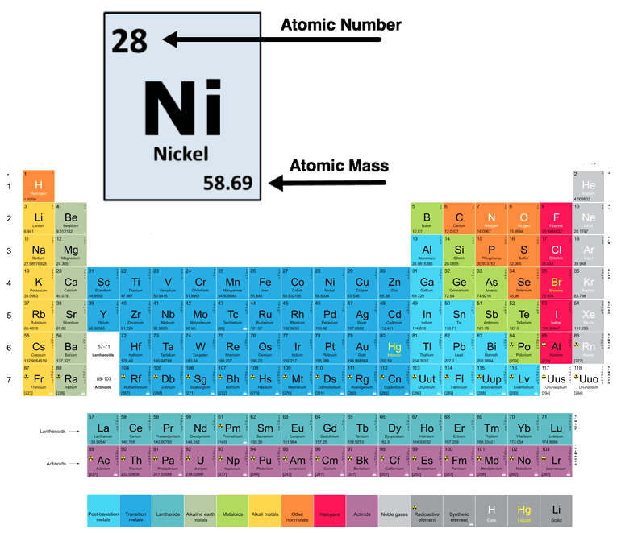
In this Smart Lesson you will learn to:
Recall that elements are represented by symbols.
Explain that the atomic number is based on the number of protons in an atom.
Describe how the periodic table is based on the atomic number and the properties of the elements.

Slide 3
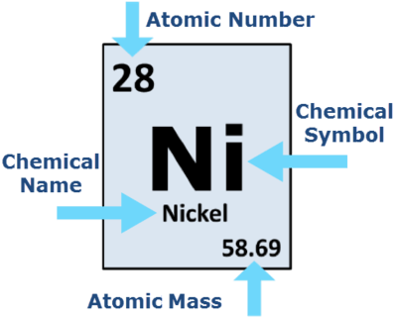
The symbol representing the element can be chosen in several ways:
Many elements uses the first letter of their names. For example, oxygen is O, phosphorus is P and nitrogen is N.
When a letter is already taken (chlorine can't be C because that's carbon) most elements will use two reasonable letters. For example, chlorine is Cl, calcium is Ca and zinc is Zn. The first letter is a capital letter, but any other letters are lower case.

Slide 4
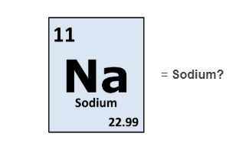
So why is sodium written as Na?
Some elements have symbols that seem really strange. These are usually using one or two reasonable letters, but for another language!
For example, gold is Au (aurum in Latin), tungsten is W (wolfram in German) and sodium is Na (natrium in Latin).

Slide 5
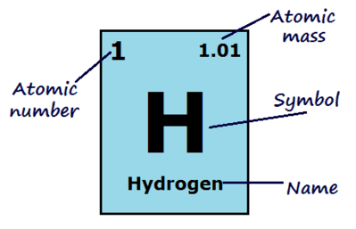
The atomic number of an atom is how many protons the nucleus has.
This is what defines an element! If an atom has 1 proton it is hydrogen, if it has 8 protons it is oxygen and if it has 94 protons it is plutonium.

Slide 6

Atoms are neutral.
They have the same amount of electrons as protons, so the atomic number of an atom is also how many electrons it has.

Slide 7
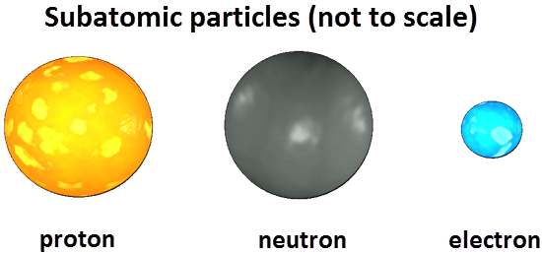
The mass number is the mass of one atom of an element.
It is the number of protons plus the number of neutrons in the nucleus of the atom.
Electrons are not considered when calculating the mass number because their mass is so small compared to protons and neutrons.

Slide 8
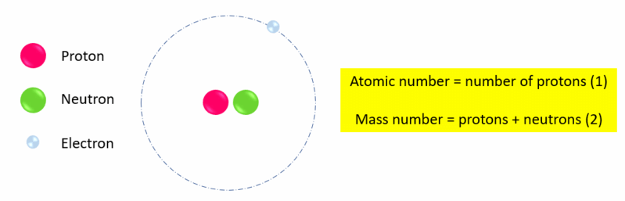
To find the number of neutrons in an atom, subtract the atomic number from the mass number:
mass number - atomic number = number of neutrons​
For example, the mass number (number of protons + neutrons) of one form of hydrogen could be 2, and the atomic number (number of protons) is 1. Therefore the number of neutrons in this hydrogen atom is 2−1=1.
The number of neutrons must always be a whole number (should not include any decimal places).

Slide 9

Because elements are only defined by the number of protons they have, they can have different numbers of neutrons.
Both neutrons and protons contribute to the mass of an atom, so different atoms of the same element can have different mass numbers.
Atomic mass is the average mass number of an element. Being a calculated average, the atomic mass is usually not a whole number. This is the value displayed on the periodic table alongside the atomic number.

Slide 10
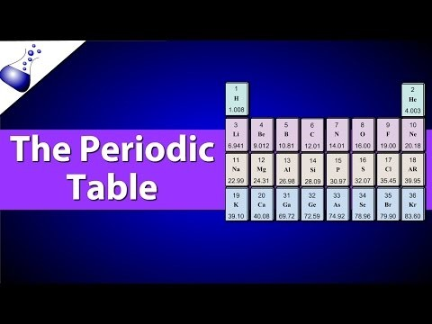

Slide 11
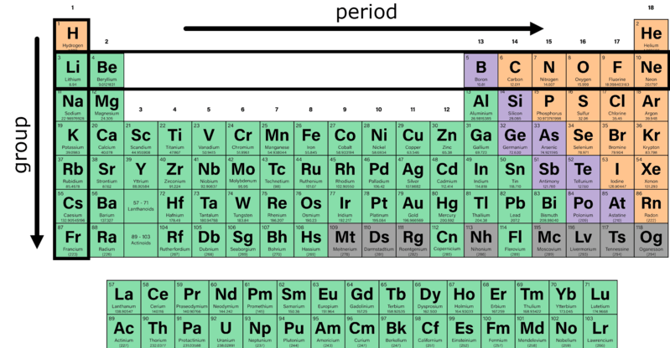
The Periodic Table is a table that shows us all the elements.
Each element is ordered by increasing atomic number.
As shown, it consists of eighteen vertical columns (groups) and seven horizontal rows (periods), with two extra rows below.

Slide 12
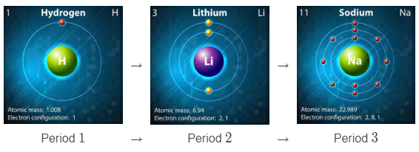
Each period represents another electron shell being filled.

Slide 13
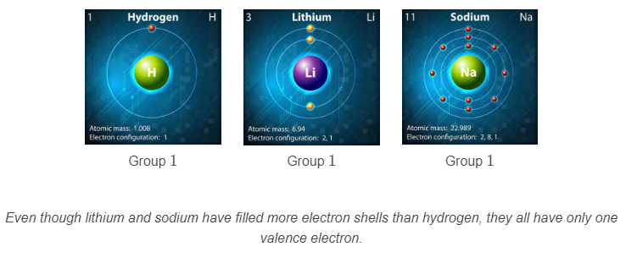
Each group contains the elements with the the same number of valence electrons (electrons in their outer shell).

Slide 14
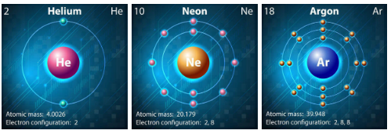
Elements are grouped by the number of valence electrons because these are the electrons that are involved with bonding, and therefore dictate the properties of an element.
For example, every element in group 18 (the noble gases) has a full outer shell, and none of them react except under extreme circumstances.

Slide 15
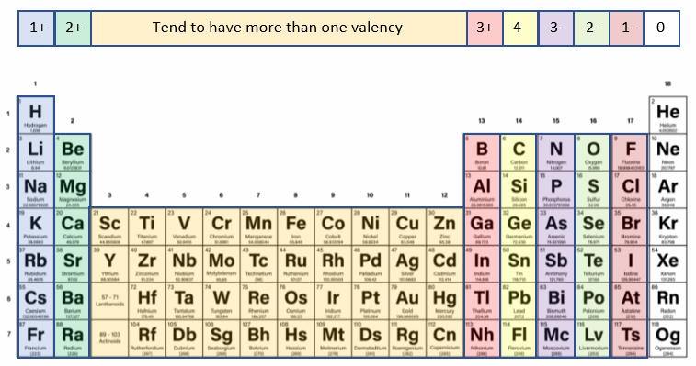
The number of valence electrons can be used to help predict the valencies of the different groups.
Valency is the combining power of an element. Elements in the same group of the periodic table have the same valency.

Slide 16
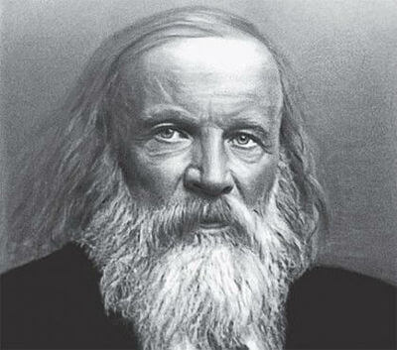
Russian chemist Dmitri Mendeleev (1834-1907) created the original periodic table.
He arranged the known elements in rows according to their mass (protons had not been discovered yet), and columns according to their properties.

Slide 17
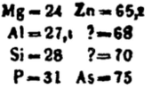
What was impressive about Mendeleev's periodic table was that he left gaps for some elements that weren't yet discovered, two of which are shown here:
The question marks correspond to gallium (atomic mass of 69.7 and discovered in 1875) and germanium (atomic mass of 72.6 and discovered in 1886). He even somewhat accurately predicted their properties, such as melting point and density

Slide 18

Mendeleev also placed some heavier elements in front of lighter ones if their properties were more similar to those of other groups.
This was later discovered to be because the atomic number defines an element, not the atomic mass.
The most abundant isotope of tellerium (Te) has more neutrons than iodine (I), however tellerium has one less proton than iodine, and therefore goes first.

Slide 19
If you're ever deciding whether or not to put in some extra effort, just think about this:
A scientist called Lothar Meyer published his version of the periodic table at the same time as Mendeleev, but didn't try to predict any new elements.
Which one is known as the father of the modern periodic table and has an element named after them?

